Slide 1




Climate Box
Module 2
Topic 2.1.1.2 Recommendations for using the interactive learning toolkit "Сlimate box" for out-of-school and additional education
United Nations Development Program
2020

Slide 2


TEXTBOOK SECTIONS FOR SCHOOL CHILDREN
"CLIMATE BOX"
“The Problem of Climate Change”
"How climate change affects nature and humans. Is it possible to adapt to its inevitable consequences?"
"How to prevent dangerous climate change"
Methodological recommendations for teachers on the use of the interactive learning toolkit "Climate Box" at school.
2

Slide 3

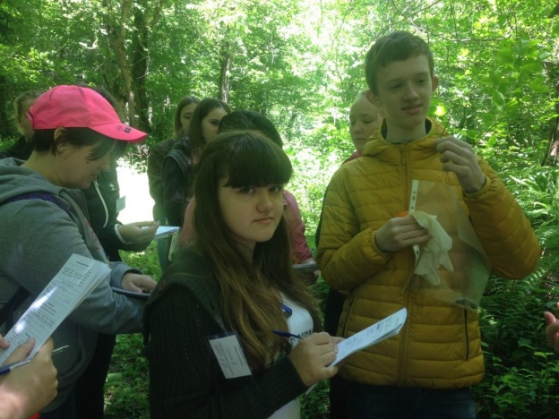

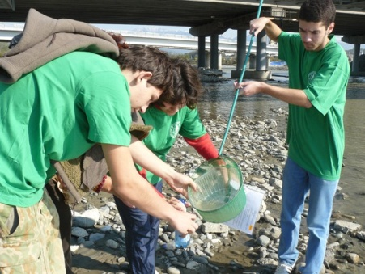
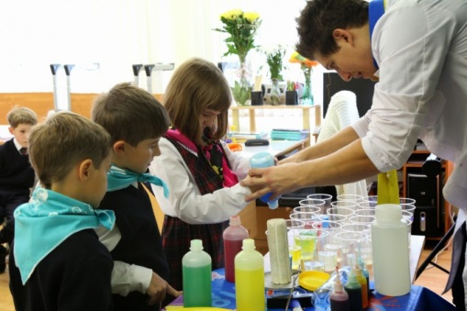
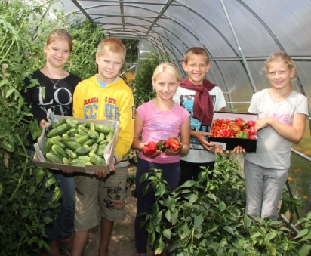
FEATURES OF A MODERN EDUCATIONAL PROCESS
The educational process at the present stage should contribute to the formation of such skills as explaining phenomena, hypothesizing and testing hypotheses, predicting events, analyzing data, justifying and discussing the results of experiments. The features of the Manual allow you to select a wide range of such problematic tasks.
Extracurricular work broadens the horizons, promotes self-education skills, the development of creative abilities, forms the worldview and active life position of students.
Combining lessons and other educational activities to enhance children’s climate change literacy will help them develop a basic scientific worldview,, intellectual abilities, and cognitive interests.
3

Slide 4
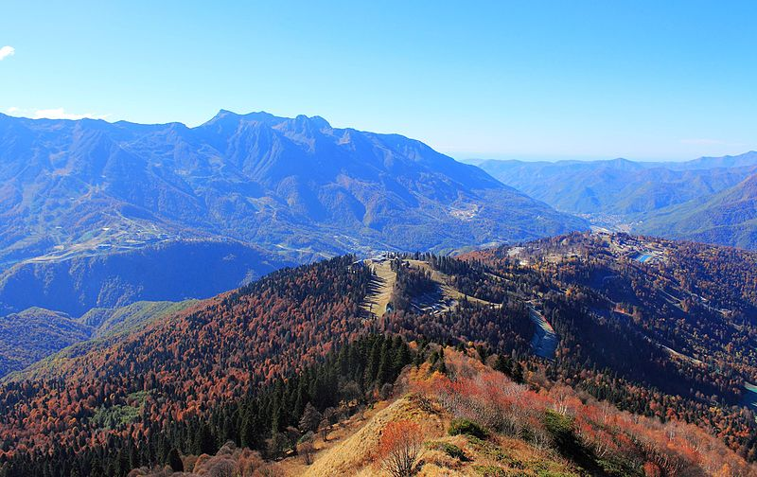
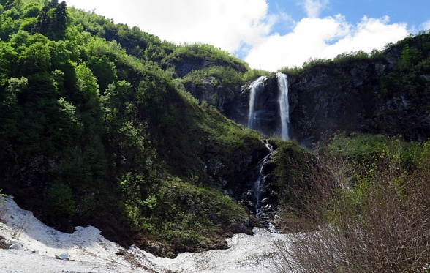
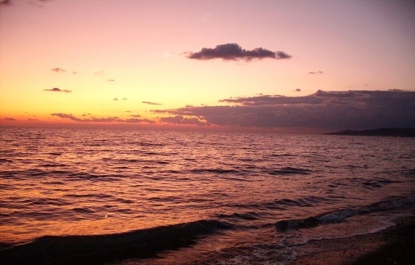
1. ADDITIONAL EDUCATION PROGRAMS
Elective program
"Sochi is the city of Russian Subtropics", 17 hours
Author: Gridasova Evelina Mikhailovna, teacher of geography at Lyceum No. 23, Sochi, Russia
The course is designed for an in-depth study of the climatic features of Sochi. It provides an opportunity to get more complete knowledge about the unique climate features of the territory, the only subtropics in Russia, surrounded by mountains and forests of the national Park and the Caucasian biosphere reserve. Studying such topics as "How climate change affects mountain regions"," coastal areas"," forests " are relevant and understandable to local students.
Additional general educational program “Nature Researchers the Climate" – 144 hours
Author: Vera Lebedeva, teacher of additional education at the Ecological and Biological Center in Sochi, RF.
The program is developed on the basis of the interactive learning toolkit "Climate Box“. It has a large practical component aimed at developing practical skills in the field of climate change and prevention of its consequences. The program’s research areas include the amount of transport, weather anomalies, plant diseases and pests, and much more. The implementation of projects aimed at reducing climate change impact, collection of waste paper, reuse of plastic bottles in the training and experimental areas of the center, processing Christmas trees into wood chips and its further use, and others.
4

Slide 5
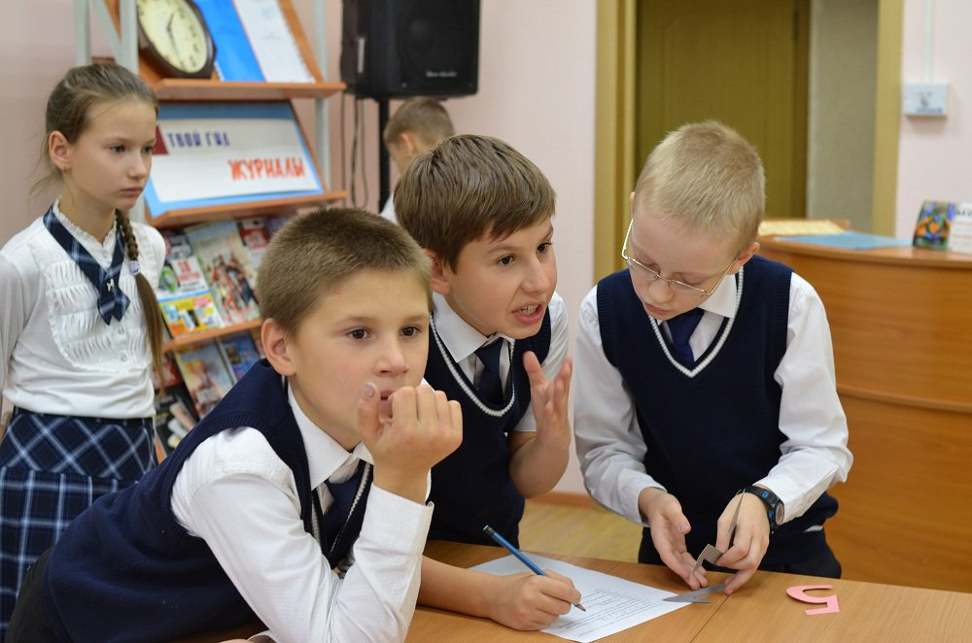

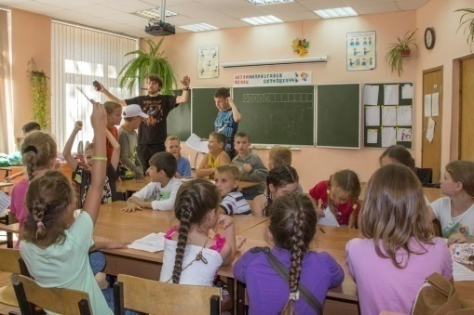
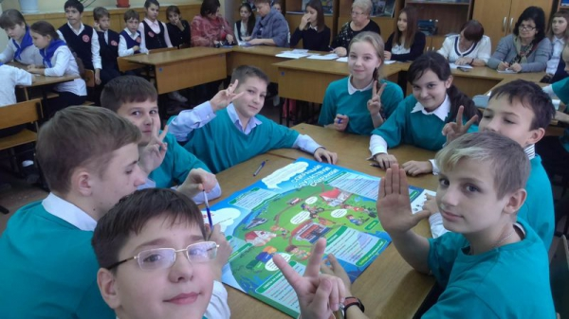
2. DISPUTES. DISCUSSIONS. ROLE-PLAYS
Solving disputes over controversial issue through dialogues can be part of educational process where they can engage in taking into account the opinions of all participants and achieving an agreed position. A role-play can be a good option to practice it.
The essence of the role play is to create situations in which each participant gets a fictitious name, a social role such as a journalist, the company's chief executive, an environmental expert, and so on.
Role-playing game creates motivation that is close to natural, arouses interest, and increases the emotional level of students.
Example of topics for debates and role-playing games:
Construction of an incineration plant in the city;
The expansion of highway through roadside landscaping;
Construction of a dam on the river that supplies the city with water;
others.
5

Slide 6
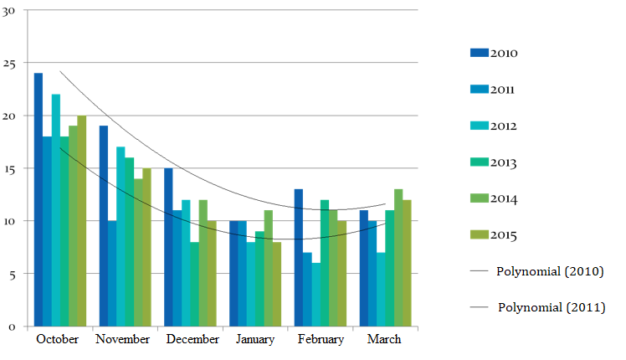
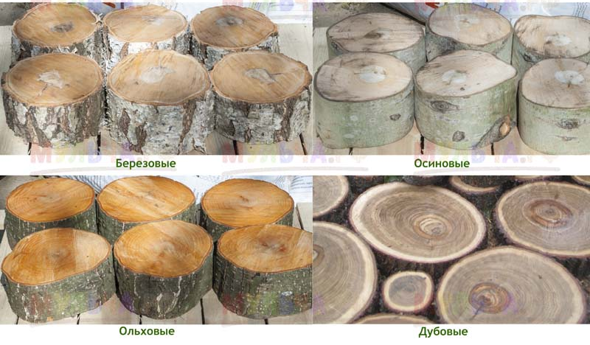
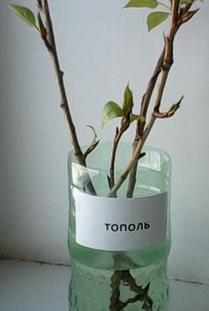
3. INDEPENDENT WORK
Independent work is a cognitive and an educational activity performed according to the instructions of a teachers, under their guidance and control but without their direct involvement. It can take place during the study of new educational material, solidifying of knowledge, preparation of the report, creative work, project design.
In the process of independent work on climate topic, it is important and necessary to involve parents in collaborative work with children.
Extracurricular activity
"How does climate change affect forests?"
Independent experiments:
find out which trees and shrubs are most sensitive to warming.
find out which tree species has the most carbon in its wood.
compare the amount of oxygen and carbon dioxide released by plants in the light and in the dark.
Birch
Aspen
Example of a creative independent task:
use data from the hydrometeorological service (from the Internet) to plot a chart of the cold or warm season in your city.
Alder
Oak
6
Poplar

Slide 7
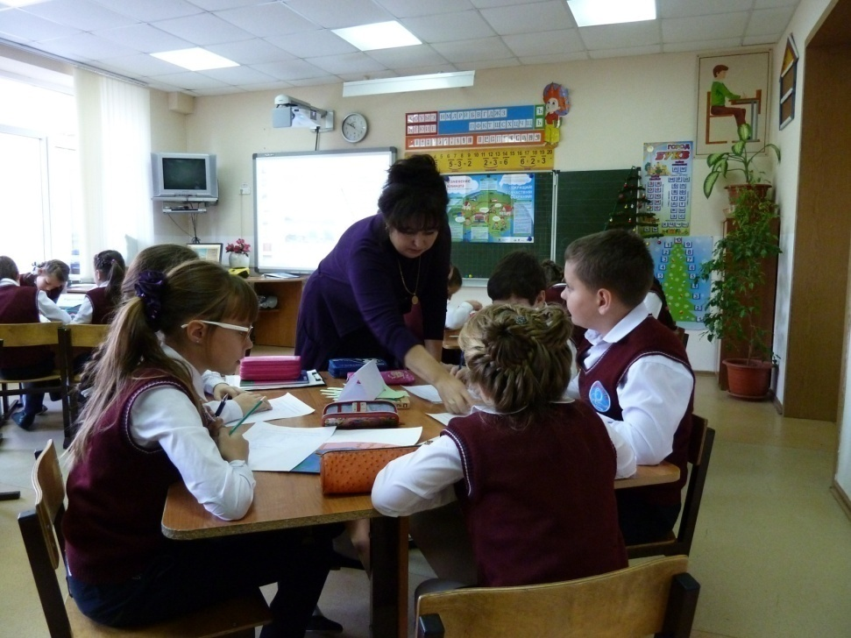

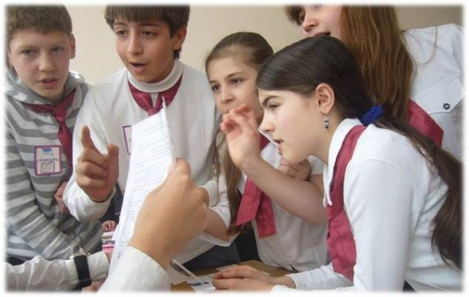
3. INDEPENDENT WORK
Round table
"How can I help the planet?"
Independent task for groups:
1 - make observations and notes of the cases of inefficient use of energy by humans.
2 - make observations and notes of the cases of efficient use of energy by humans.
3 - study materials in the media confirming the need for energy saving.
Presentation of the material.
Creative independent task "Energy Patrol"
Analyze the number of kilowatt hours spent in different months of the year, the reasons for the highest and lowest electricity consumption, and suggest ways to save energy in everyday life: in the kitchen, when washing, cleaning, and in other cases.
7

Slide 8
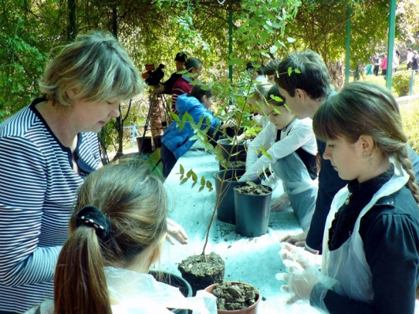
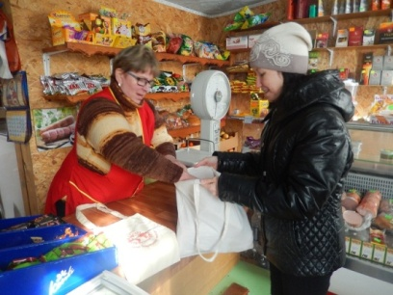
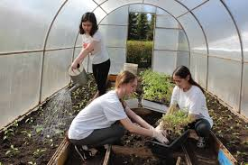
4. PROJECT METHOD
Currently, the most popular method of teaching among teachers. The project method assumes the following approach: “
Think, how it could be done and what means to use – justify – calculate the effect – do – describe so that others can do it.
Examples of projects carried out by students from different countries aimed at reducing the carbon footprint and reducing the impact on the climate:
Energy-efficient houses in the city of Labytnangi to reduce carbon emissions;
Wax moth to control plastic waste. The project aims to reduce greenhouse gas emissions by optimizing the process of recycling plastic waste;
Fresh water desalinatorproject. A device that allows, in domestic conditions, as well as in the conditions of small enterprises and educational organizations, to obtain fresh water from the highly mineralized water of the deserts and semi-deserts of Central Asia by condensation;
"Automated Garden". Project for the development and implementation of a device that allows to optimize the process of watering gardens: to perceive dry beds and moisturize the dry land in a short time through drip irrigation.
Eucalyptus cultivation project to combat waterlogging.
When organizing extracurricular activities on climate change, it is necessary to use the resource of the educational organization. These can be schoolyard, greenhouses where you can use resource-saving technologies, and other.
8

Slide 9
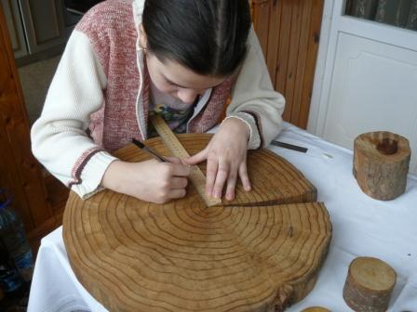
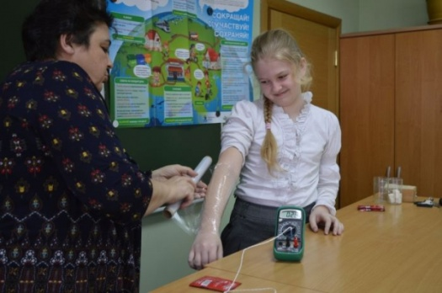
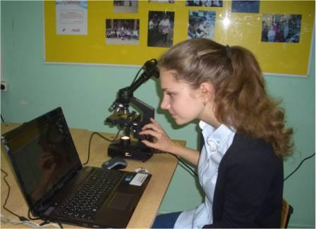
5. RESEARCH ACTIVITIES BY STUDENTS
The research activity by students is an education organization for completing students' creative, research tasks with previously unknown results in various fields of science, technology, and art.
By studying climate change issues, students can do various research activities to determine the degree of impact on the climate of a particular factor. The results will not only contribute to a deep understanding of the problem, but also allow students to make suggestions to reduce the impact of a given factor or factors, as well as, draw public attention to the situation.
Examples of research projects performed by schoolchildren on the study of factors affecting the climate:
Determination of the carbon pool in different kinds of wood on in Nadym district;
Studying the carbon footprint of students in class 5A of MBGEI "Gorkovskaya GSS";
Highway transport in the city: problems and solutions.
9

Slide 10
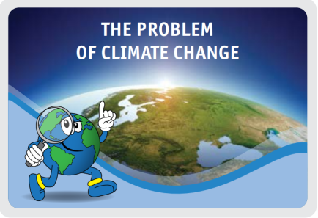
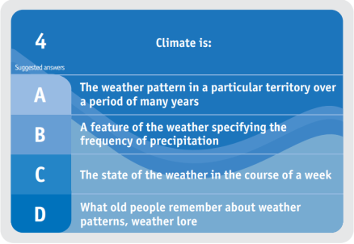
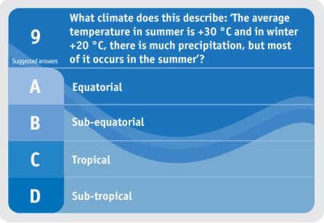
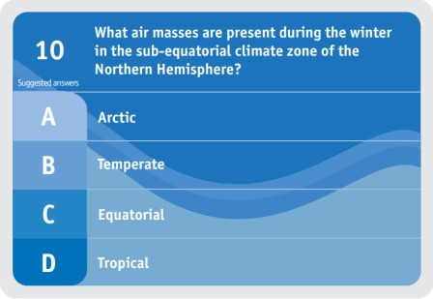
6. GAMES
| "The game is a spark that ignites the light of curiosity"
(Sukhomlinsky)
Role-playing game
Game library - board games
The game is one of the unique forms, it is a conditional entertaining activity aimed at the formation of knowledge, skills and abilities. As a type of learning session, games implement a number of principles of active learning, which differ in the presence of rules of game activity, a fixed structure and evaluation systems.
In educational terms, the effectiveness of participants in the game allows the teacher to assess the level of knowledge and the ability of students to apply this knowledge in practice.
The game is almost always a competition. The spirit of competition in games is achieved through an extensive grading system of the participants' activities in the game.
The "Climate box" tasks provide a variety of games designed for both individual and collective participation. At the same time, teachers piloting the "Climate box" in countries have developed many additional games that cover almost all the topics of the manual, with a wide use of both classical and modern approaches, using new technologies and electronic learning tools.
Game form of classes
Contests, quizzes
Situational play
Theatrical games
10

Slide 11
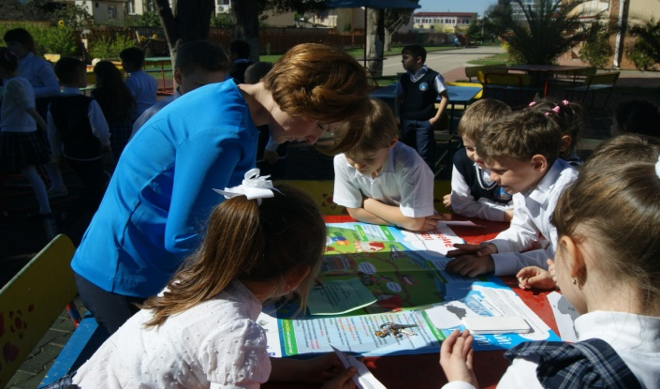
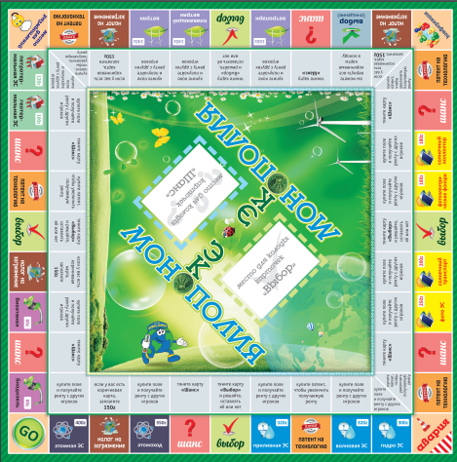

6.1. QUIZ. COMPETITIVE GAMES
Quizzes are held on cards or in an interactive format, through a presentation.
Quizzes can be used at events and as an independent task, by posting them on the school's website (class, Association, etc.). Answering the questions of such a quiz, a student goes from one stage to another, gaining the appropriate number of points for the correct answers.
Lotto for elementary school students on the topic "Weather and Weather Anomalies". Names of the elements of the weather are encrypted in the squares. It is necessary to collect the broken parts of words as quickly as possible so that they mean the meteorological elements that determine the weather.
The very popular games "by stations", quests in which participants move from one stage to another answering questions and solving situational problems related to climate change.
Our colleagues from Kazakhstan have come up with a climate Lotto and a board game ecomonopoly, where participants, moving along the playing field, earn "money" by organizing a living space with the lowest carbon footprint.
CHECK YOURSELF!
Which lamp is the most efficient?
CLO | HU | RA | RE
MOS | UD | PI | CI
TU | WI | SCO | GS
PRE | TA | MI | ND
TEM | DI | DIO | BI
FO | TION | PE | TY
11

Slide 12
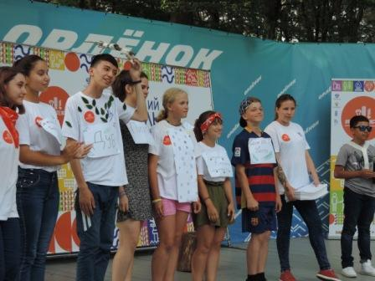
6.2. THEATRICAL GAMES
Role-playing, business and theatrical games are one of the interactive learning technologies. Today, the method of theatricalization is actively used at all levels of education.
Theatrical performances on the theme of climate change can be prepared in advance with special costumes. Such performances can be shown both at school events and outside of school, for example on public themed holidays, promotions.
Spontaneous theatrical productions are very popular in camps, expeditions, and other non-formal settings. In this case, children quickly invent the scenario with a fairly simple content, but with a bright emotional coloring. Costumes are prepared from improvised materials and can be quite symbolic. Such productions, from the idea to the performance, usually take place in one day. This approach mobilizes the creative imagination of participants, it does not require them to have professional acting skills, so a large number of children take part in them happily.
In 2019, during the thematic shift at the Russian Child Center "Orlyonok", after a lecture on climate change topic, students participating In "Climate Box" projects, prepared creative scenes on two of the topics related to the consequences of climate change: "Forest Conservation" and "Water Resources Reduction". In a humorous way, children acted mini-plays.
12

Slide 13
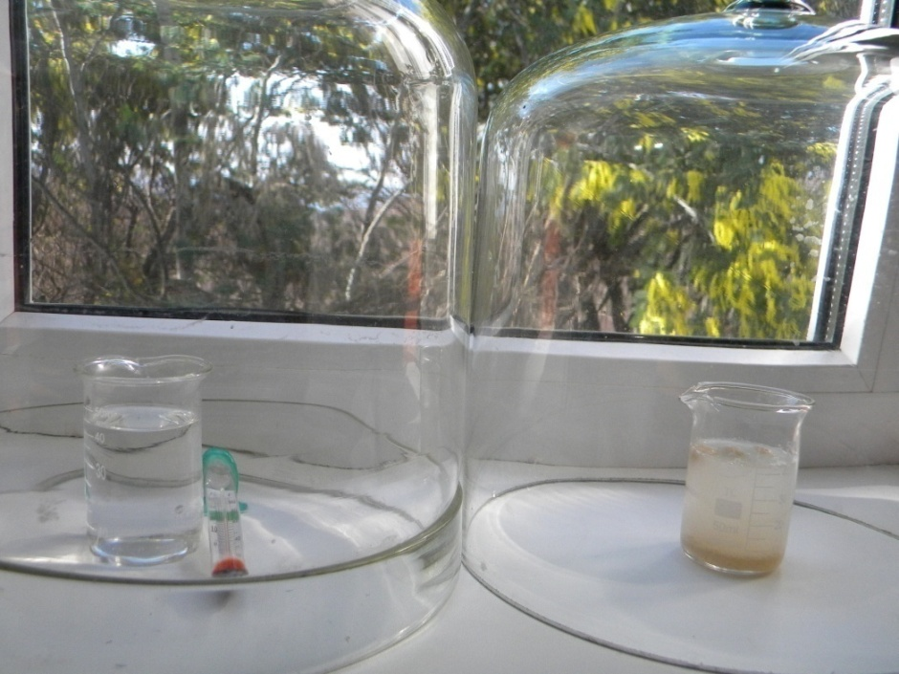


7. DEMONSTRATIONS. MEETINGS WITH EXPERTS
The demonstration can be held both in the classroom and at an extracurricular event, depending on the topic and objectives of the event, for example:
demonstration of energy-saving (resource-saving) equipment’s;
watching films, cartoons, TV shows and other media products on consequences of climate change topic and ways to reduce the impact on the climate;
presenting other visualizations about the effects of climate change and ways to reduce the impact on climate.
Meetings with experts.
During extracurricular activities, climate scientists are invited to talk about the system of meteorological observations in the region, the findings of observations in recent years, and the consequences of climate change. You can also invite:
experts of specially protected nature conservation areas;
experts of organizations implementing low-carbon production technologies;
social workers involved in organizing events to reduce the burden on the climate;
scientists from leading scientific organizations that deal with climate issues.
13

Slide 14
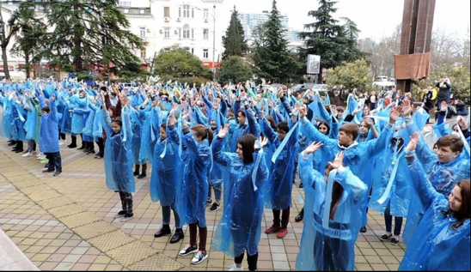
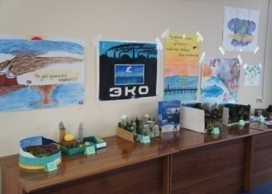
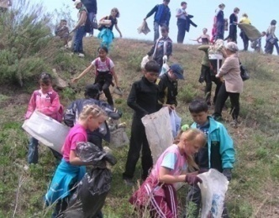
8. MASS HOLIDAYS
(COLLECTIVE AND CREATIVE AFFAIRS)
Theme parties, festivals of creativity and imagination; the contests are usually dedicated to the international environmental dates:
Earth day (March 20),
World Water Day (March 22),
World Wildlife Day (March 3),
World Meteorological Day (March 23), which is held to raise awareness on the possible consequences of climate change among the general public,
Earth Hour (March 24),
International Mother Earth day (April 22).
During these days, competitions are held for theater productions, readers and authors, drawings and posters on climate change. Properly captured children's drawings and posters prepared for these events can be used as information material for booklets, calendars, and other products. You can prepare materials for the exhibition for such events in advance, during the year.
For example, the photo contest "Weather gets nervous", where children during the school year take photos of unusual or dangerous weather events (hurricanes, thunderstorms, storms, floods) and then these works are presented at a photo exhibition for world meteorological day.
14

Slide 15
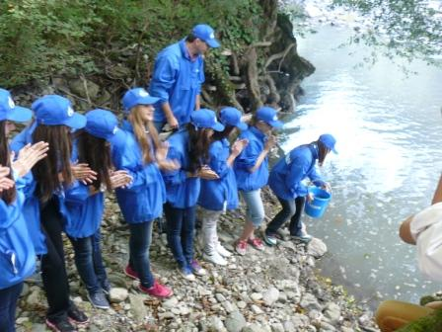
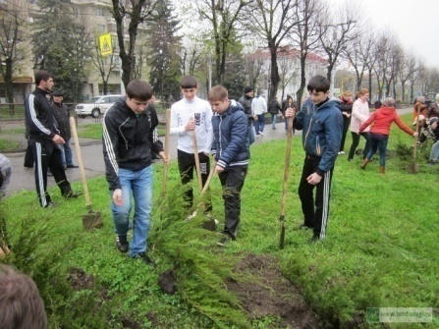
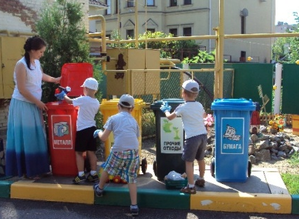
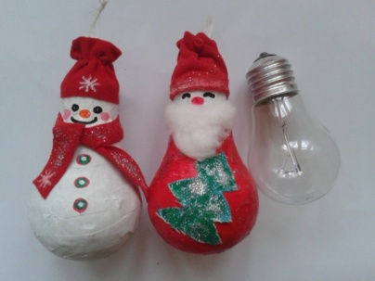
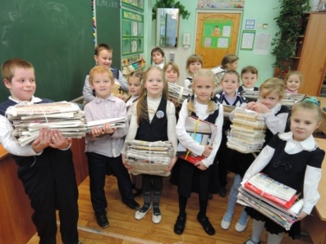
9. SOCIALLY USEFUL AND SOCIALLY SIGNIFICANT EVENTS
Biodiversity conservation - release of Black Sea salmon from the nursery into the river.
Gardening campaigns, collecting plastic bottles and caps, batteries, and waste paper. Competitions for creative work on "recycling" topic, for example plastic bottles recycling in the household or decorating a Christmas Tree with used light bulbs, which turn into toys, animals, stars and other Christmas decorations, with the help of creativity and imagination of children, parents and teachers.
‘Tree for Recycling" campaign is being held in the Ecological and Biological Center of Sochi. After the New Year holidays, residents of the city bring Christmas Trees to process into wood chips, and then to use for bedding for animals, filling garden paths and other needs.
15

Slide 16
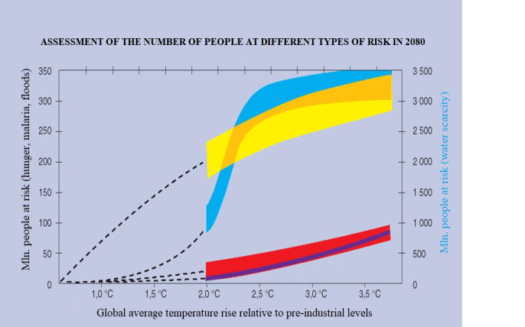
10. ADVOCACY ACTIVITY
Advocacy inform the population about climate change through education system. These can be specially designated stands with information in the school, information on the covers of diaries, bookmarks for books, headings in school newspapers with publishing activity.
Information about the causes of global climate change and its consequences for nature and humans will be interesting and important for children and their parents. Posters with risk forecasts which are fraught with water shortage, the growth of infectious diseases and hunger will help to understand and feel the problems of climate change and how it affects everyone. This information can be found on the school stands, on the webpages of schools, on social networks and other associations.
In addition to general information, it is important to promote information about the benefits of recycling glass, plastic, paper, and metal. As well as what influences the size of the "carbon footprint" and how to organize your lifestyle to reduce it.
Children can develop such posters and information sheets by themselves. Such drawings can be placed on calendars, notebooks, and other printed products.
Risk of water scarcity
Malaria risk
Hunger risk
Risk of coastal flooding
Global average temperature rise and water problems
10 ° С - small mountain glaciers in tropical countries completely disappear, problems with water supply for 50 million people.
20 ° С - 20-30% reduction in water resources in sensitive regions (Mediterranean, Africa, Central Asia ....)
30 ° С - up to 4 billion people are forced to reduce water consumption
40 ° С - reduction of water resources in sensitive regions by 30-50%
50 ° С - the disappearance of large glaciers, the most serious problems with the water supply of China and India, etc.
16

Slide 17
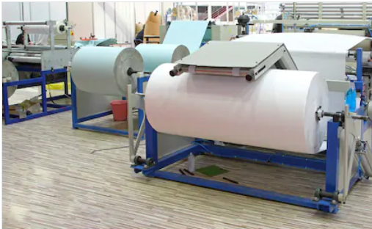
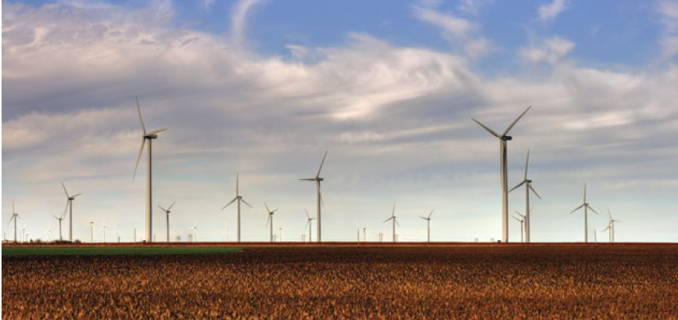
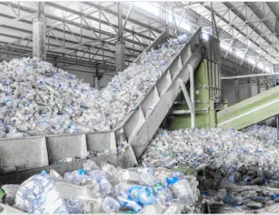
11. EXCURSIONS
Excursions are usually organized to plans where resource-saving technologies are implemented. It can also be:
waste sorting plans;
plans that process secondary raw materials such as plastic, glass, paper;
plans that produce products from recycled materials;
etc.
Excursion to the paper mill.
Making paper from recyclable materials (waste paper)
Excursion to the wind farm
Excursion to the waste processing plant
17

Slide 18
It is important to involve parents in extracurricular and non-formal educational activities.
Parents together with their children take part in research, creative tasks and promotions.
Thus, extracurricular activities, as the main type of educational process, allows you to form a child's worldview and also to influence parents through them.
LIST OF ILLUSTRATIONS
The photos and illustrations used in the module, where sources are not specified, are either taken from the Climate Box toolkit (see the List of illustrations at the end of the textbook) or provided by the program participants.
Sources of additional illustrations:
Slide 4
Top photo: Commons.wikimedia.org (SKas)
Photo below (from left to right):
1 – Commons.wikimedia.org (Alexandra Zaitseva)
2 – Commons.wikimedia.org (Sasha Denisov)
Slide 16
Photo based on Parry et.al.,2001 materials
Slide 17
Top photo: Shutterstock.com (Baloncici)
The photo below: Shutterstock.com (Alba_alioth)
18

Slide 19

THANKS FOR YOUR ATTENTION!

